Slide 1
Mendix ML Kit and OpenAI
AI in Low Code Development

Slide 2
AGENDA
ML Kit
Overview of ONNX
Classification
ResNet50
Style Transfer
OpenAI
Overview of OpenAI
ChatGPT
Dalle3

Slide 3
ONNX – Open Neural Network Exchange.
Framework Flexibility: It allows developers to easily switch between different machine learning and deep learning frameworks, like TensorFlow, PyTorch, and MXNet, for training and deploying models without being locked into one ecosystem.
Ease of Deployment: ONNX models can be deployed across a wide range of platforms and devices, including cloud, mobile, and edge devices, facilitating broader application use cases without extensive customization.
Performance Optimization: Leveraging ONNX Runtime can lead to enhanced performance in model inference, including faster execution times and lower computational resource requirements, thanks to its optimization capabilities.

Slide 4
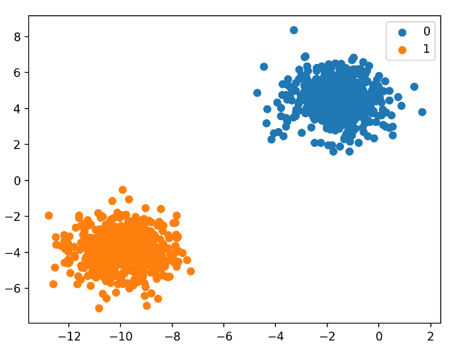
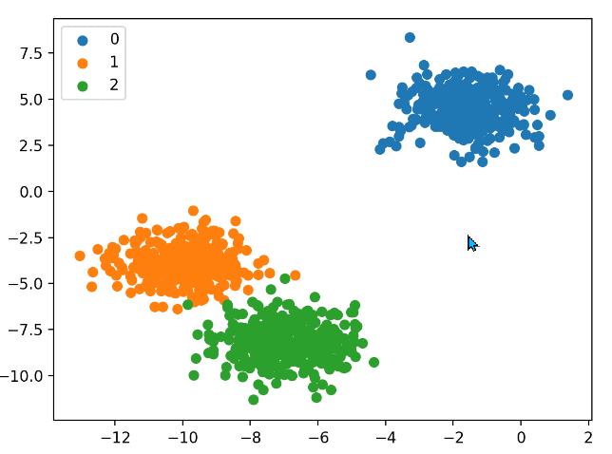
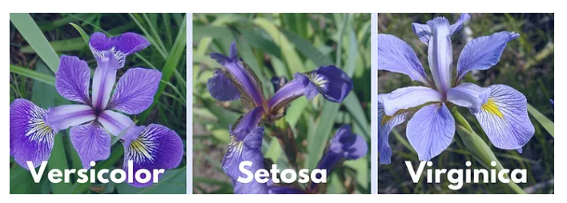
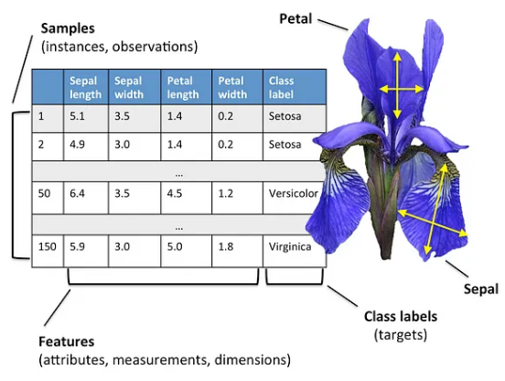
Classification
Binary Classification
Multi-Class Classification
Iris Class

Slide 5
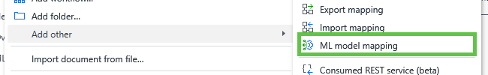
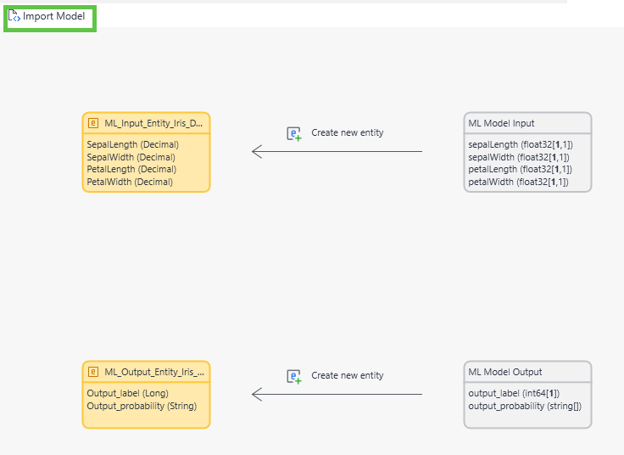
Classification Cont.

Slide 6
Demo

Slide 7
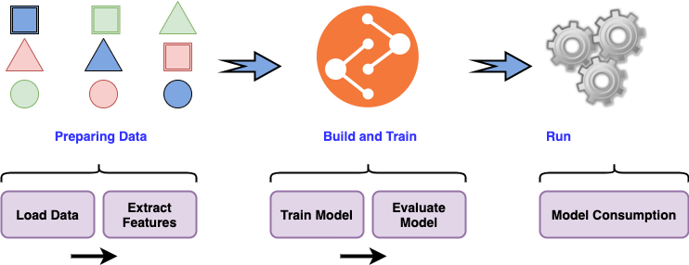
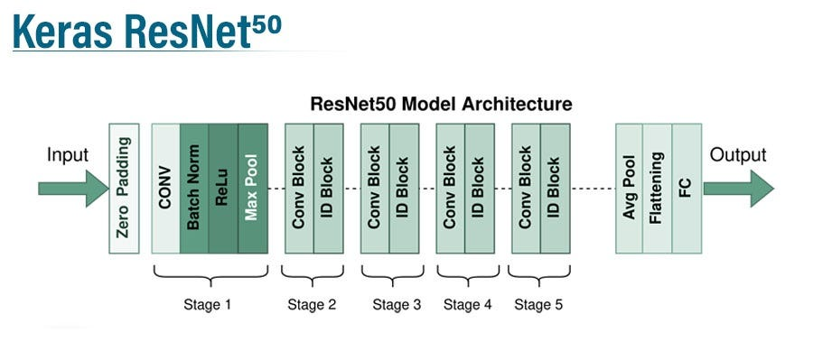
RESNET50
How to build a pre-trained model
ResNet50 Layers

Slide 8
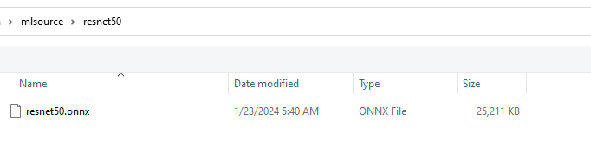
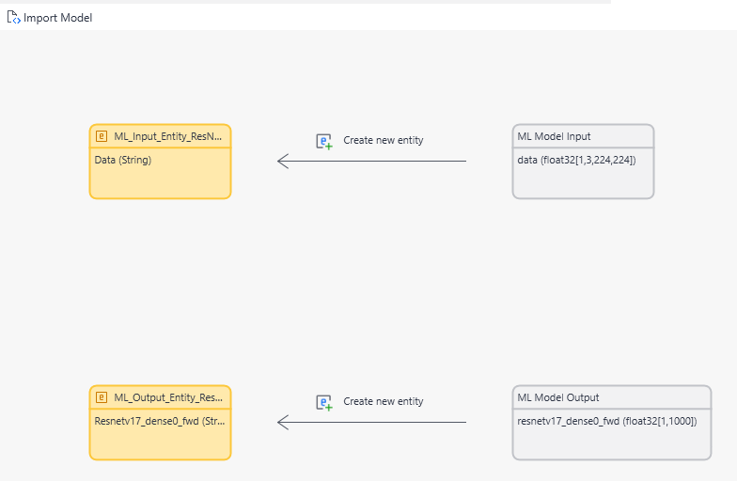
RESNET50 Cont.

Slide 9
Demo

Slide 10
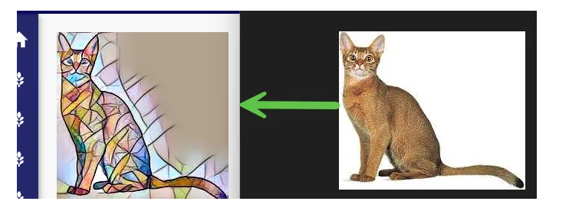
Style Transfer
Style transfer is a computer vision technique that takes two images—a content image and a style reference image—and blends them together so that the resulting output image retains the core elements of the content image, but appears to be “painted” in the style of the style reference image.

Slide 11
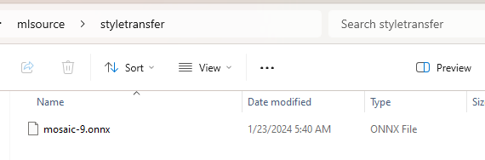
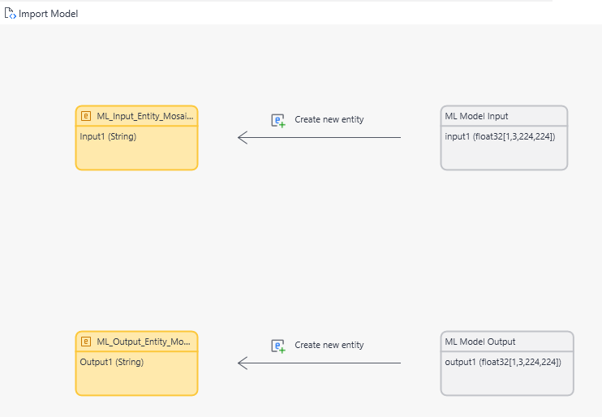
Style Transfer Cont.

Slide 12
Demo

Slide 13
Resources
https://qnttran.medium.com/mendix-ml-kit-be-a-machine-learning-practitioner-in-low-code-development-74e87f58db8d

Slide 14
Overview OpenAI
OpenAI has made significant contributions to the field of AI through research, development of advanced models like GPT (Generative Pretrained Transformer) series, and the creation of innovative technologies that push the boundaries of what AI can achieve, all while advocating for ethical considerations and safety in AI development.
https://platform.openai.com/ - an Api framework provide REST endpoint
https://chat.openai.com/ - monthly subscription for chatting and asking question
Moreover, we have DALL-E 3 for image generation.

Slide 15
What ChatGPT can do ?
On this single endpoint https://api.openai.com/v1/chat/completions
Answering a question.
Generate product description content.
Summary the content in proper way.

Slide 16
Image Generation
On this single endpoint https://api.openai.com/v1/images/generations
Generate image based on text description

Slide 17
Demo

Slide 18
Resources
https://qnttran.medium.com/chatgpt-use-cases-981fee8a954b

Slide 19
Thank you
Contact
Quang Nhat Tran
Technical Lead
Mobile +66 06-4419-4428
#YourTrustedDigitalSolutionsPartner
#TheMendixLowCodeLeader

